Slide 1
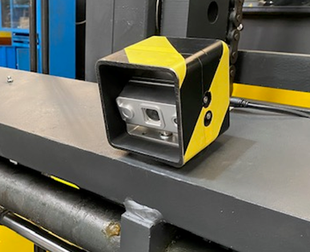
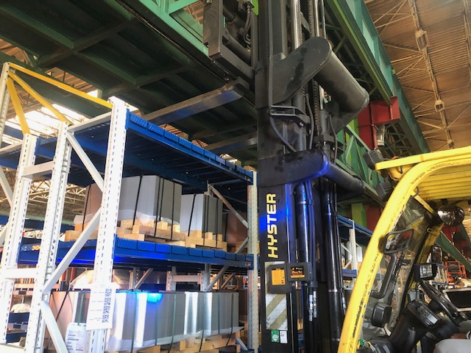
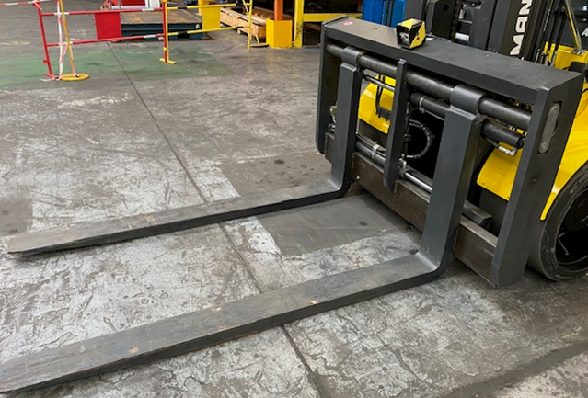
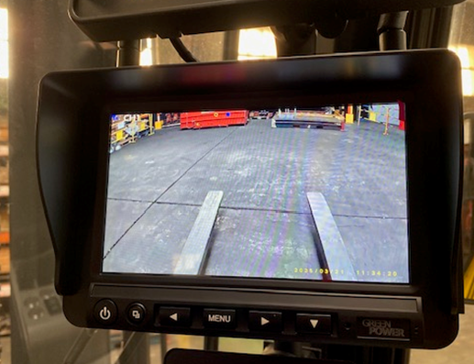
Installation of Forks viewing camera on Forklift
Before :
- Missing visibility to stack pallet and using rack storage of wood pallet
- Driver can’t know if the forks are takeout from the pallet
After :
Installation of Forks camera on Forklift to increase the visibility + check the takeout of forks from the pallet
Cost of global project = 2 618€ / forklift
Mike SCHMIDT, Project & Method, AMTB Lorraine

