Slide 1
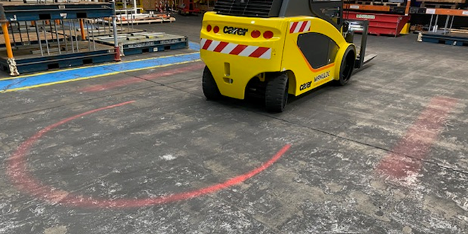
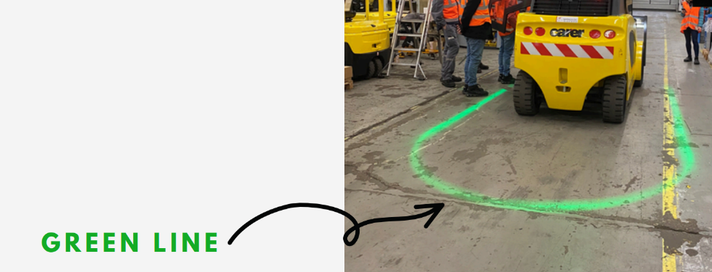
Installation of greenline system (led) on Forklift
Cost of global project = 1 227€ / forklift
Before :
No information that the forklift put the handbrake
No information that the forklift don't move, and the person can approach the driver/forklift
The Light remains red all the time
After :
Installation a GreenLine to inform the person that the forklift is stopped and handbrake put. People can approach to discuss with the Driver
Mike SCHMIDT, Project & Method, AMTB Lorraine

